Slide 1
NHS England: Virtual Wards NW Region: COO Directorate / Improvement
NW-NHSE System Improvement Co-ordination Team
Virtual ward SRO: Steve Barnard
Improvement Programme Lead: Marie Higgin-Aspinall
Date of document: Nov 24
Author: Marie Higgin-Aspinall

Slide 2
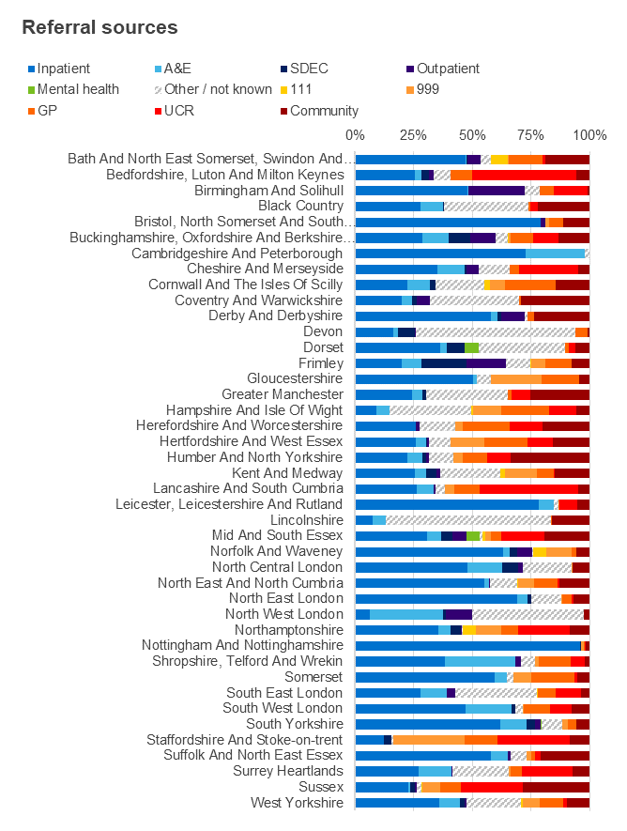
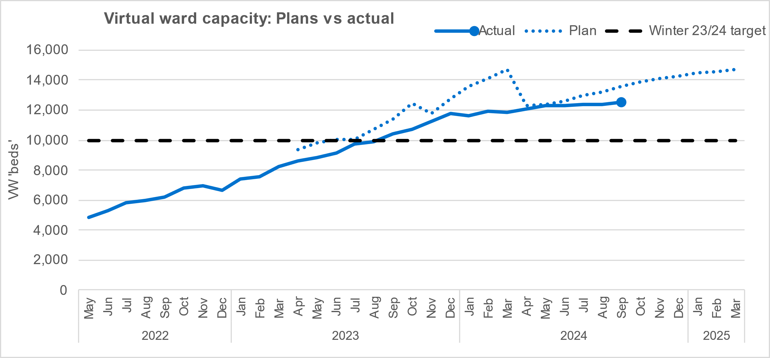
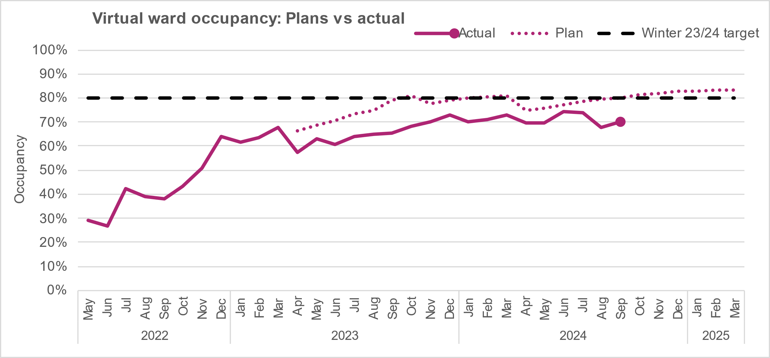
Virtual Wards: National Virtual ward capacity – number of patients who can be managed simultaneously on virtual wards.​ Occupancy – snapshot number of patients in virtual wards as a percentage of capacity ​​ Data source: fortnightly virtual ward SitRep​ (last SitRep in month)
Key headlines:
In September 2024, the number of Virtual Ward ‘beds’ is 12,497 this is a growth of 158% since May 2022 (4,845 'beds’).
Occupancy has increased to 70%, with more wards submitting data and less data quality issues than the previous monthly period.
In this two-week reporting period:13,704 patients have received acute level care at home through virtual wards:
47% is acute care need associated with frailty
16% is acute respiratory infection (ARI VWs)
37% of activity is for other cohorts (e.g., Heart Failure)
Nationally, over 600k patients have been admitted to virtual wards since April 2022.
Latest Period: September 2024
Next Update: 24 October 2024

Slide 3
ICS Name | Population | No of Providers | No of Virtual Ward Services | Total VW Capacity | VW Capacity per 100K | VW Occupied per 100K
NHS Cheshire and Merseyside ICB | 2,774,716 | 10 | 26 | 429 | 15.5 | 11.5
NHS Greater Manchester ICB | 3,264,077 | 10 | 26 | 962 | 29.5 | 16.5
NHS Lancashire and South Cumbria ICB | 1,852,079 | 7 | 18 | 419 | 22.6 | 15.6
North West Region | 7,890,872 | 27 | 70 | 1810 | 22.9 | 14.5
England | 63,227,624 |  |  | 12497 | 19.8 | 13.9
Key headlines:
Metrics – Track, monitor review in different ways
Understand the demand, skills of the teams to right size the capacity and optimise opportunities for throughput
Increase referral opportunities via different sources; via SPOA, UCR, ED, Inpatients… other areas…’pull and push’..!
How are services profiled on DoS / Service finder ? – Inclusion / exclusion criteria.. ‘no wrong door’ approach…
Collaborate on our virtual ward platform:
Virtual Wards Network - FutureNHS Collaboration Platform
VW operational framework self assessment tool - Virtual Wards Network - FutureNHS Collaboration Platform

Slide 4
End

